Slide 1

Human Vision: Physiology
CS 498: Virtual Reality
UNIVERSITY OF ILLINOIS AT URBANA-CHAMPAIGN
Eric Shaffer

Slide 2
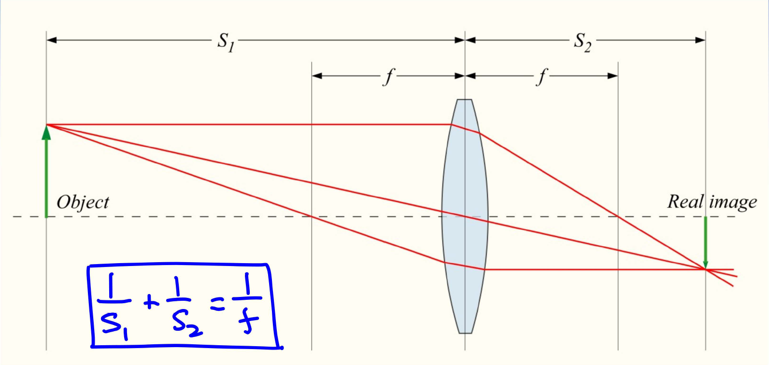
Review: Imaging Properties of a Lens
Object is at distance > f, its “real image” is in focus at distance s₂.

Slide 3
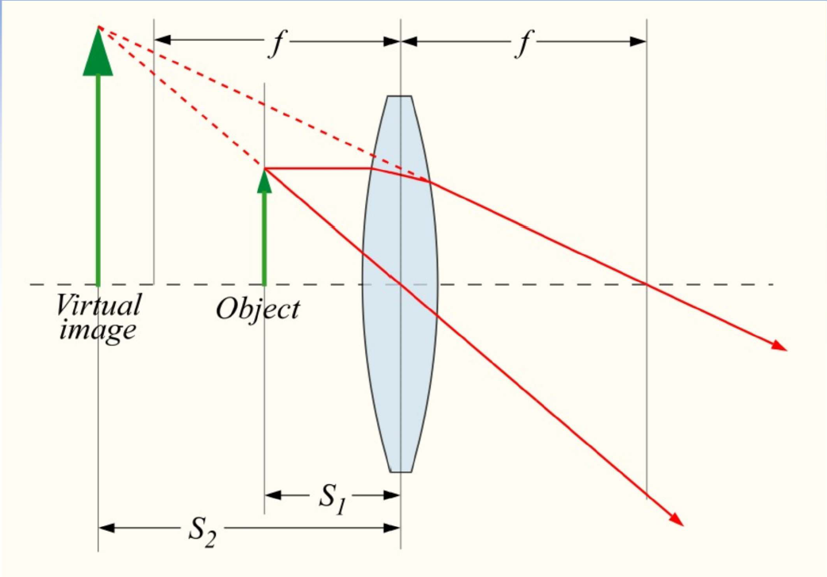
Beyond Review: Magnification
Object is at distance < f, its “real image” is not in focus.
The “virtual image” is formed at behind the lens…we see this enlarged image through the lens…
“Virtual image” is not a real image…that wording just implies that it’s like we are seeing an object that size.

Slide 4
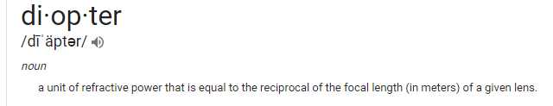
What is a Diopter?
Diopter measures how much the lens bends light
Magnification measure by what factor the size of the image is increased
These quantities are related…can you derive the conversion?
Notes:
Using the lens equation: 1/s1 + 1/s2 = 1/f. s1 should be f away from the lens, so that s2 is infinity
The diopter of the human eye is about 58D. The ciliary muscle can increase the diopter of the eye by about 10D.

Slide 5

What is a Diopter?
Diopter measures how much the lens bends light
Magnification measure by what factor the size of the image is increased
These quantities are related…
It’s usually approximated as $M=\frac{D}{4}+1$
The algebra yields something like $M=−d_{i}D+\frac{d_{i}d_{o}}{d_{i}d_{o}}$
Diopter is measured in meters! Well…m⁻¹
Notes:
Using the lens equation: 1/s1 + 1/s2 = 1/f. s1 should be f away from the lens, so that s2 is infinity
The diopter of the human eye is about 58D. The ciliary muscle can increase the diopter of the eye by about 10D.

Slide 6
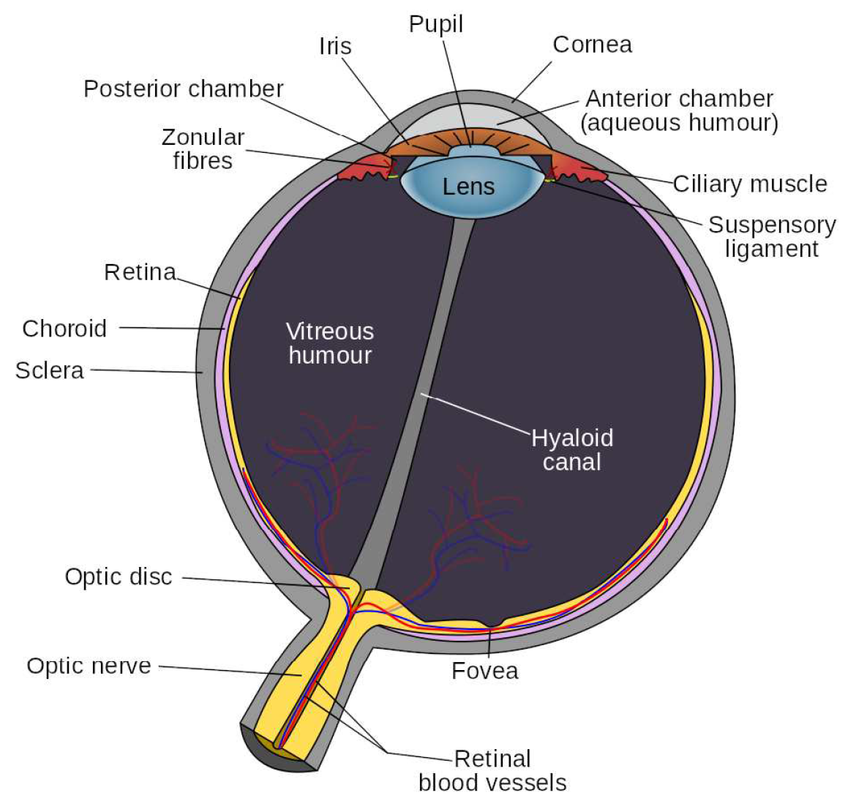
Structure of the Human Eye
Key Physical Components
Cornea: bends light…like a lens Aqueous Humour: liquid..bends light
Lens: can change the diopter of eye …uses ciliary muscle to change shape
Vitreous Humour: liquid..bends light
Retina: sensory array of cells
Fovea: greatest concentration of receptors
Notes:
Cornea is optical lens does most of the convergence. (D~40). Aqueous humour = latin for liquid. Pupil = iris to allow light in. Lens = most important for changing the focal distance. Increase the optic power using ciliary muscle to squeeze lens. In VR you don’t have to. Is it OK or bad?
Virtreous - refracts the light. || light to the prinicipal axis of the eye. Fovea = biggest concentration of photoreceptors.

Slide 7
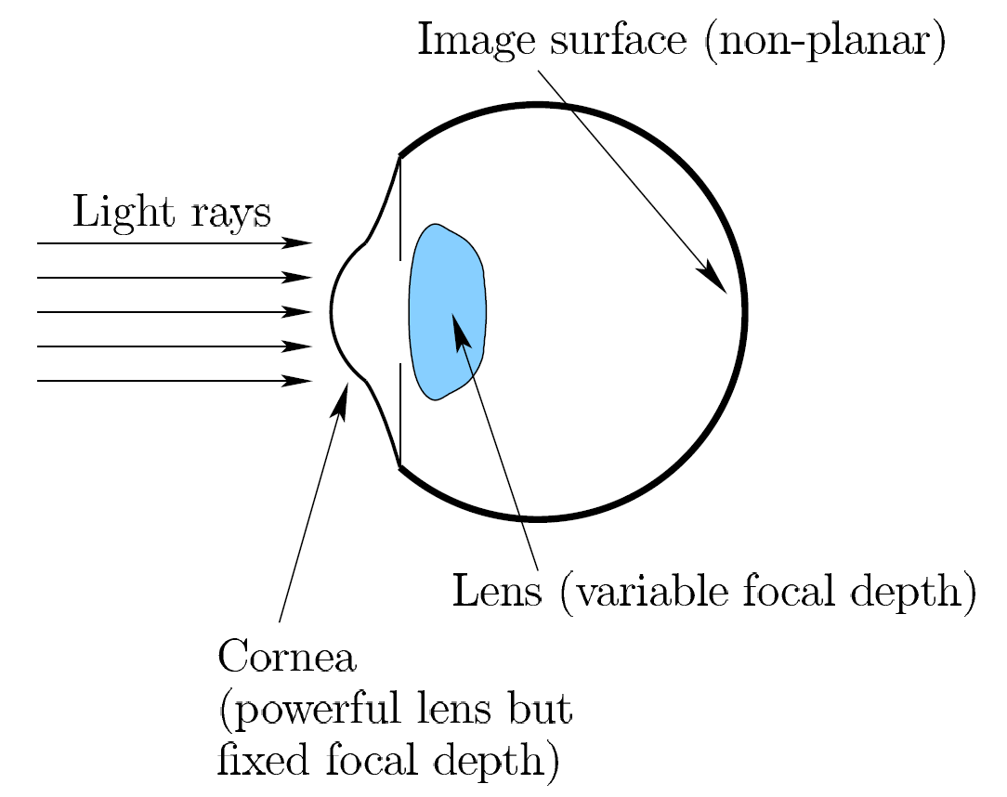
Structure of the Human Eye

Slide 8
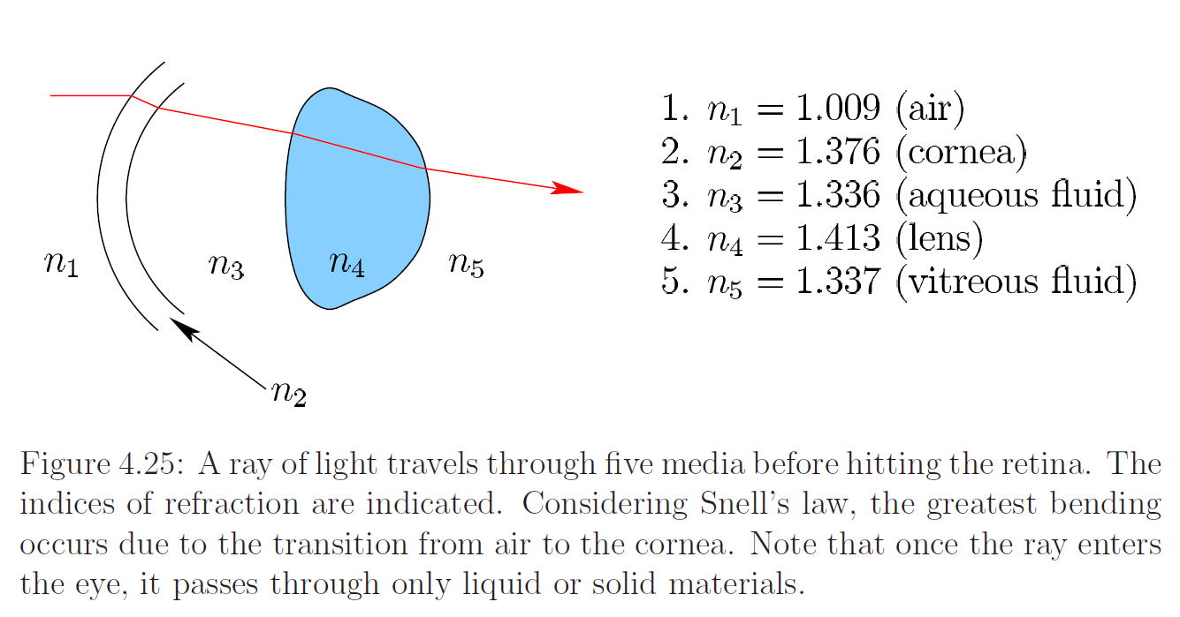
Optical Power of the Human Eye

Slide 9
Structure of the Human Eye
The diopter of the human eye is about 58.
Eye lens is not spherical.
Retina (and retinal image) is not planar.
Ciliary muscle has the ability increase diopter by +10 (lose at age ≈ 40).
Optic nerve forms a blind spot in the human eye.
What physical element is not typically used when experiencing VR?
Assume the person has no vision defect.
Notes:
A

Slide 10
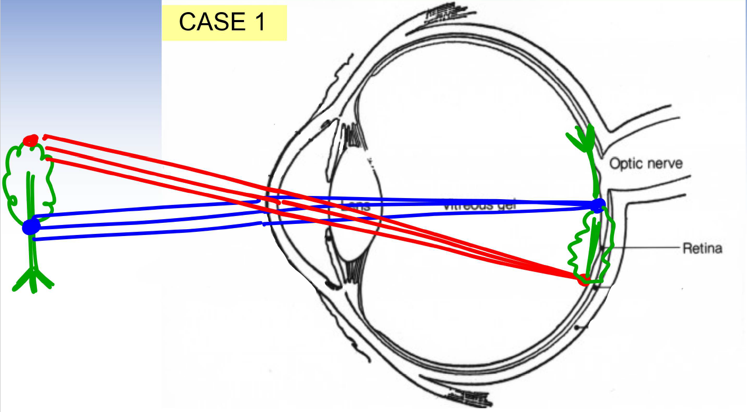
Imaging System Inside of a Human Eye
The eye muscle is relaxed.
Object is at infinitely far away. Rays are parallel.
Rays get converged on retina.
The image is in focus.

Slide 11
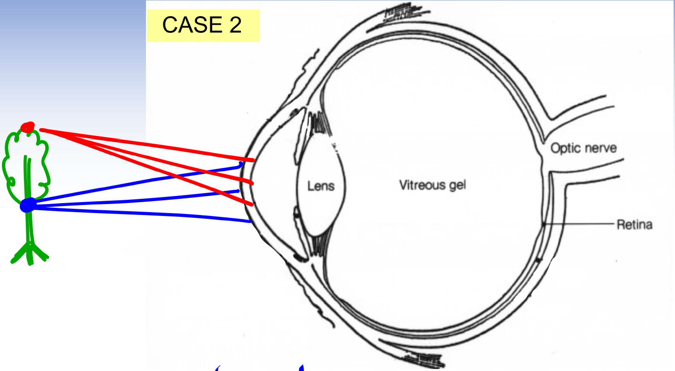
Imaging System Inside of a Human Eye
The eye muscle is relaxed.
Object is “nearby” Rays are diverging.
The rays do not get converged on retina.
The image is blurred .

Slide 12
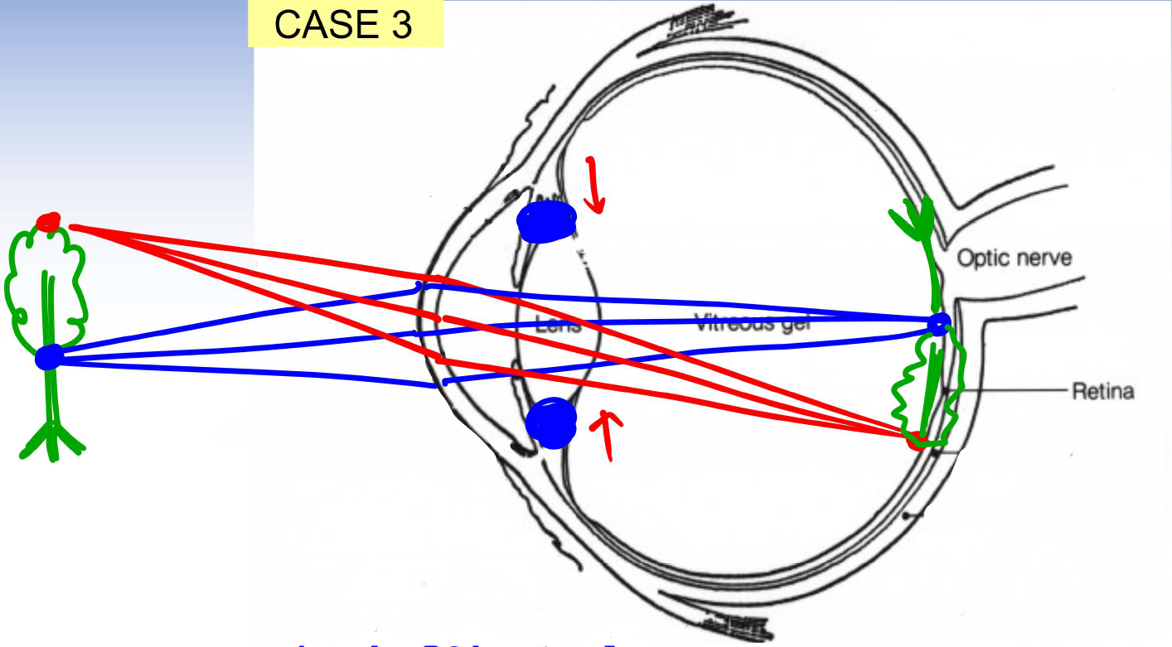
Imaging System Inside of a Human Eye
The eye muscle is not relaxed .
Object is nearby. Rays are divergent .
The rays do get converged on retina.
The image is in focus.

Slide 13
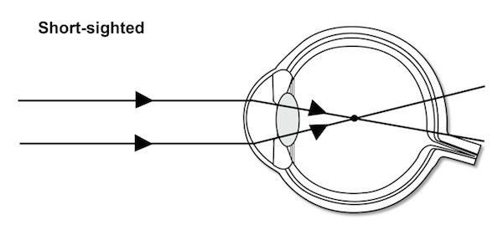
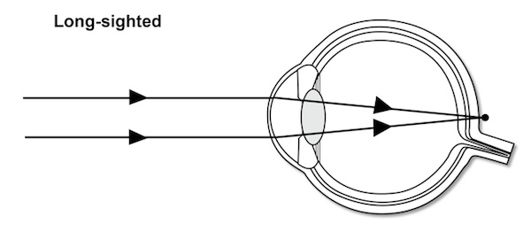
Vision Defects of a Human Eye
What should the shape of the corrective lens be?
Can it be self-corrected?

Slide 14
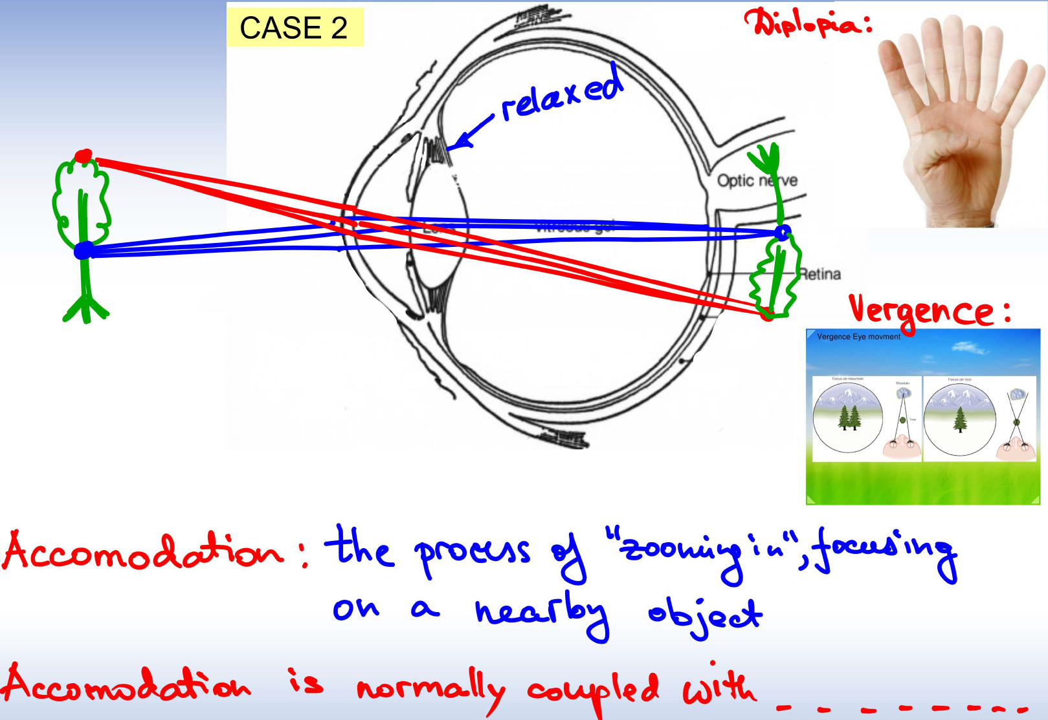
Imaging System Inside of a Human Eye

Slide 15
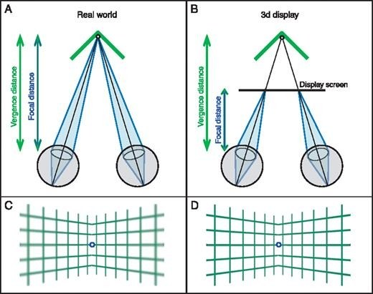
Vergence-Accommodation Conflict
Eyes are accommodating to the screen distance
Eyes converge to some other depth in virtual scene
Can cause fatigue and headaches
Still an area of current research

Slide 16
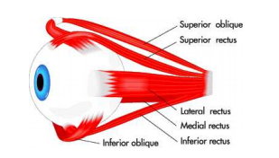
Eye Movements
When viewing an object, eyes move and scan over it
Experimentally shown that suppression of motion results in no visual perception
Six types of eye movements
Saccades
Smooth pursuit
Vestibulo-ocular reflex
Optokinetic reflex
Vergence
Micosaccades

Slide 17
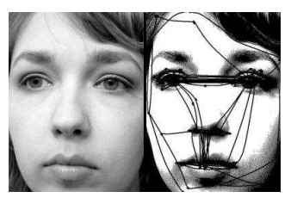
Saccades
Rapid movement
45 ms
Rotation covers 900 degrees per second
Quickly relocates fovea to important features in scene
Can be consciously controlled

Slide 18
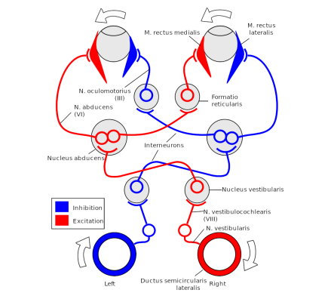
Vestibulo-Occular Reflex
Involuntary movement of the eye to counter head movement
Provides image stabilization
“Hold your finger at a comfortable distance in front of your face and fixate on it. Next, yaw your head back and forth (like you are nodding “no”), turning about 20 or 30 degrees to the left and right sides each time. You may notice that your eyes are effortlessly rotating to counteract the rotation of your head so that your finger remains in view. The eye motion is involuntary. If you do not believe it, then try to avoid rotating your eyes while paying attention to your finger and rotating your head.” Virtual Reality - LaValle

Slide 19
Other Motions
Smooth Pursuit
Slow rotation to track a target feature like a person walking by
Reduces motion blur on retina (blur due to slow photoreceptors)
Optokinetic
Rapid an involuntary feature tracking on fast-moving object
Vergence
Inward or outward rotation to focus
Microsaccades
Involuntary rotations of less than 1 degree…erratic paths…not well understood

Slide 20
Optical Illusion of the Day:
The fractal appears to move unless you fixate on single point.

Slide 21
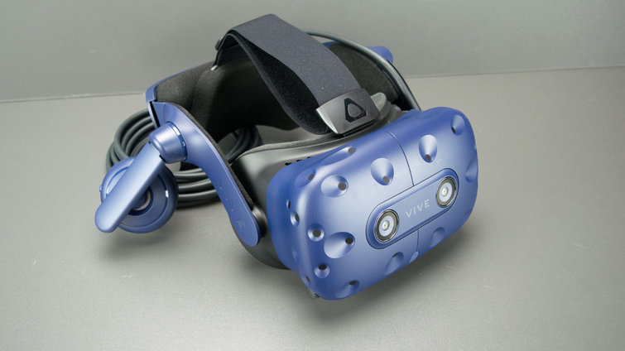
Implications for VR: Display Requirements
Key Questions
Spatial Resolution: What pixel density is needed?
Intensity Resolution: What range and resolution of brightness is needed?
Temporal Resolution: How fast do they pixels need to change value?

Slide 22


Pixel Density
In 2010, Steve Jobs of Apple claimed 326 pixels per linear inch yields a retina display
Meaning individual pixels are not discernible at a normal viewing distance
Aliasing
Screen Door Effect

Slide 23
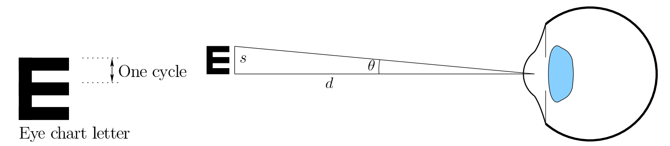
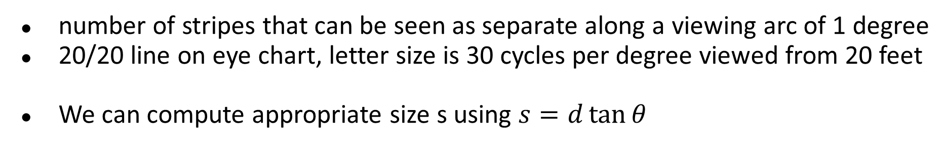
Cycles per Degree
number of stripes that can be seen as separate along a viewing arc of 1 degree
20/20 line on eye chart, letter size is 30 cycles per degree viewed from 20 feet
We can compute appropriate size s using $s=d\tan{θ}$

Slide 24
Cycles per Degree and the Retina display
Person with 20/20 vision viewing screen that is 20 feet (6.096m) away
To generate 30 cycles per degree, it must have at least 60 pixels per degree. The size would be s = 20 ∗ tan 1 = 0.349ft, which is equivalent to 4.189in. So 60/4.189 = 14.32 PPI would be sufficient.
Suppose that a smartphone screen is placed 12 inches from the user’s eye. s = 12∗tan 1 ◦ = 0.209in. This requires that the Screen should have at least 60/0.209 = 286.4 PPI. This is satisfied by the 326 PPI originally claimed by Apple.

Slide 25
Cycles per Degree for VR
Young people (gamers?!) often have higher visual acuity…up to 77 or more cycles per degree…would need around 4500 PPI
There are lenses…screen is very close…let’s say 1.5in
So, s = 1∗tan 1 ◦ = 0.0261in
Display must have at least 2291.6 PPI to achieve 30 cycles per degree
More complicated in practice (e.g. intensity can affect acuity, etc.)
HTC Vive Pro is 615 PPI Some 2018 R&D demos of screens close to 2000PPI

Slide 26
What about Field of View?
Maximum human field of view is around 270 degrees
How does a human achieve that FOV without head movement?
Cannot just bring a flat screen closer
Lens distortion at periphery
Also, super-close lenses would require VR subjects to remove their eyelashes….
Curved screen may help, but lens problem not yet solved…..

Slide 27
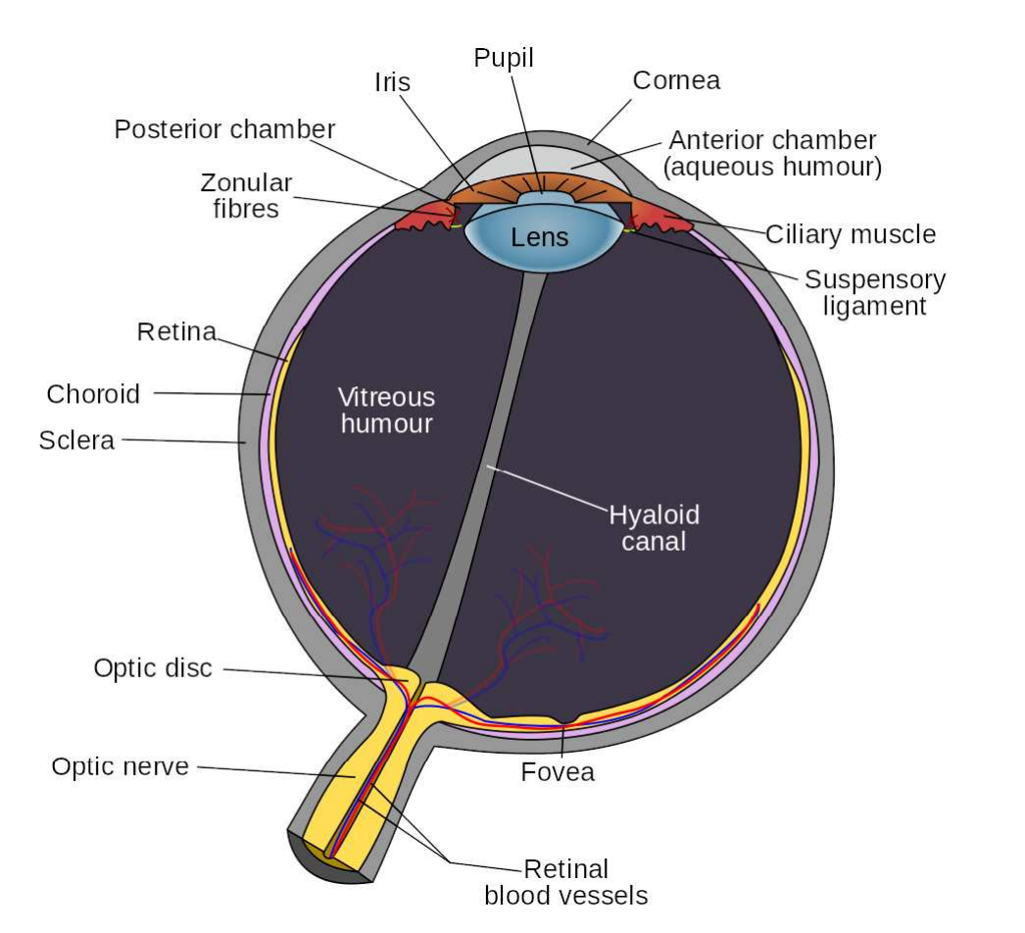
Foveated Rendering
What do you think this means?
Hint: We’re always looking for ways to optimize…to do the job with the least resources possible

Slide 28
Foveated Rendering
If we could track the eye
Keep a movable display lined up with fovea → fewer pixels needed
Has been done in practice...sort of
Fixed display
Lower resolution on periphery
Works but not well enough

Slide 29
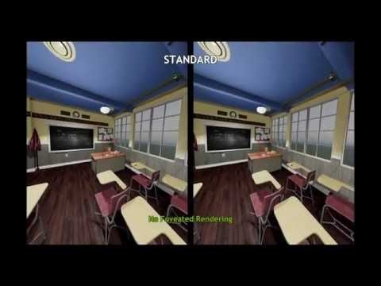
Foveated Rendering

Slide 30
VOR Gain
What does VOR mean?
VOR Gain is a ratio compares the eye rotation rate (numerator) to counter the rotation and translation rate of the head (denominator)
Head motion has 6 DOF….so VOR Gain has six components
For head pitch and yaw, the VOR gain is close to 1.0. For example, if you yaw your head to the left at 10◦ per second, then the eye yaws at 10◦ per second in the opposite direction.
The VOR roll gain is very small because the eyes have a tiny roll range
The VOR translational gain depends on the distance to the features

Slide 31
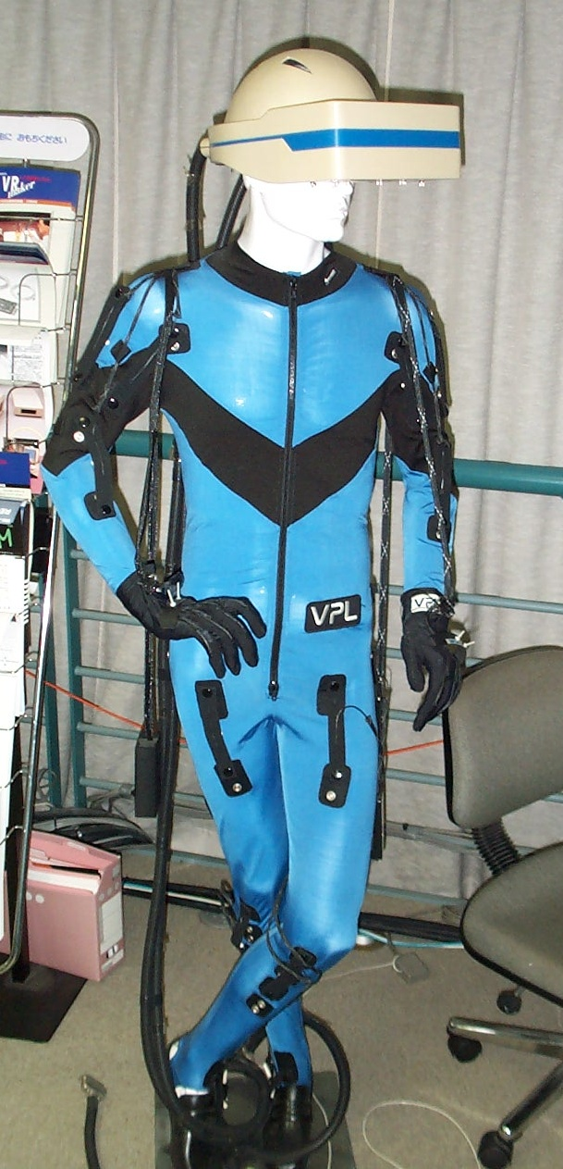
VOR Gain Adaptation
Brain will adapt VOR to different optics
Happens to people with glasses
Also happens with bad VR displays
Increases happiness with VR experience
Requires readjustment outside VR

Slide 32
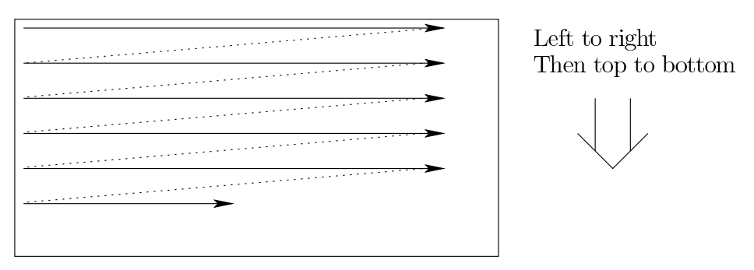
Display Scanout
CRTs used an electron beam to energize phospors on the screen…possible that your grandparents have a particle accelerator in their basement…
Most displays still work in the way as old TV sets and CRT monitors
Rolling Scanout: Updating pixels line-by-line.
For 60 FPS (frames per second) display, could take up to 16.67ms

Slide 33
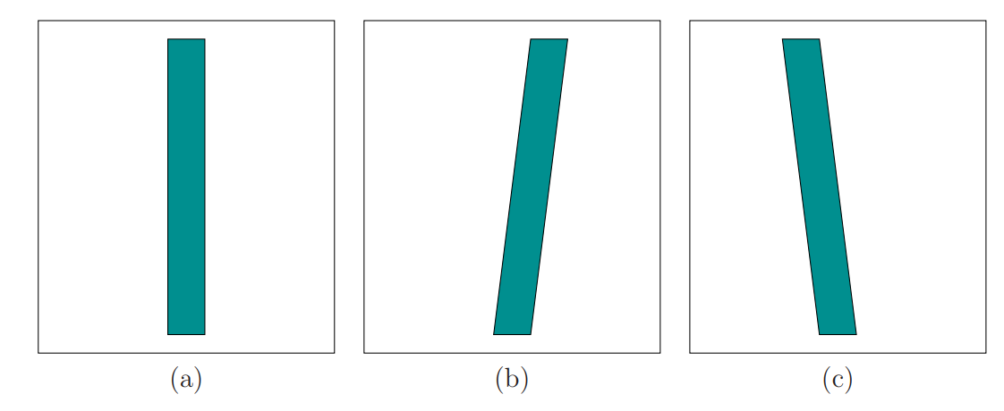
Artifacts due to Display Scanout
How could this be fixed in rendering?
(a) Normally slow recharge rate of our photoreceptors don’t see scanout But if the head or object moves in the virtual world
(b) smooth pursuit as rectangle moves right
(c) stationary rectangle with right head rotation and VOR compensation
Also might see motion blur….

Slide 34
Retinal Image Slip
We are only beginning to understand vision issues with VR
Retinal Image Slip
In the real world, head/eye motion causes small sliding of image on retina
Evidence shows that this slip is different in VR than in real world
In VR, we see increased microsaccades
Which means….?

Slide 35
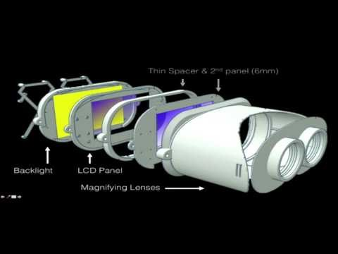
Addressing Vergence Accommodation Mismatch
Work is from 2015….difficult problem…

